Slide 1

Voice-Based Email & Messaging Assistant
Hands-Free Email Interaction Using Speech Technologies (VAANI)
Intern Names (TEAM A):Vaghdevi Pappala, Vijay Prasad, Abhinav Gupta , Aditya Singh, Sohan Kota
Mentor Name: Santhyia Krishnasamy

Slide 2



PROBLEM STATEMENT
Addressing Challenges in Traditional Email Interaction
Traditional email systems often present significant barriers to efficient and accessible communication. Our solution directly addresses these critical issues.
Manual Input Dependency
Accessibility Limitations
Demand for Voice Control
Heavy reliance on manual typing and screen interaction limits productivity and mobility for many users.
Visually impaired individuals face considerable challenges, restricting their independent access to email.
A growing need for hands-free, voice-driven email access to enhance convenience and multitasking capabilities.

Slide 3

OVERVIEW
Objectives
User Authentication & Profile Management
Speech Recognition & Command Processing
Telegram& Email API Integration
Smart Reading & Summarization
Context-Aware Reply & Draft Suggestions
Admin & Deployment Module

Slide 4




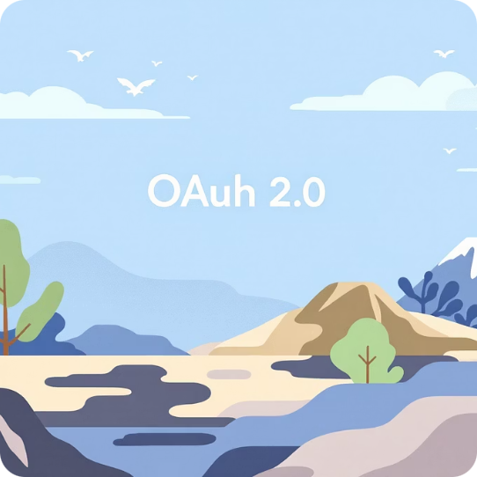


TECHNOLOGY LANDSCAPE
Core Technologies Driving the Assistant.
Web Technologies
Backend
My SQL
Gmail API & Telegram Bot
HTML, CSS, and JavaScript for the responsive frontend user interface.
Lightweight web framework for building the backend API.
database for flexible data storage and session management.
Official API for secure and structured access to Gmail services.
OAuth 2.0
Web Speech API
Gemini AI
Industry-standard protocol for authentication and authorization.
Used for Voice recognition and generation
Used for summarization, context-aware smart replies, and intelligent message analysis.

Slide 5
Secure User Verification with Face-Based Biometric Authentication
Embrace the future of identity verification with our cutting-edge face-based biometric authentication system. Designed for the dynamic digital landscape of India, this solution offers unparalleled security and convenience..
Password Verification (Knowledge Factor)
Advanced Face Recognition
Secure Google OAuth 2.0 Login
User enters username & password
Password securely hashed using Bcrypt
Backend verifies credentials from MySQL database
Our system implements advanced face recognition leveraging OpenCV’s powerful computer vision algorithms to verify users seamlessly and securely without passwords, ensuring a smooth and intuitive user experience.
Users authenticate directly via Google, ensuring trusted and secure identity verification.

Slide 6

CORE FUNCTIONALITY
Speech-to-Text (STT) Module: Voice to Command
The STT module forms the critical bridge between spoken language and actionable commands, enabling seamless voice interaction.
Audio Input Capture: Reliably captures spoken audio from the user's microphone.
Speech-to-Text Conversion: Converts the captured spoken commands into accurate text.
Primary Input Mechanism: Serves as the fundamental method for user interaction.
Hands-Free Interaction: Facilitates a truly hands-free experience for email management.

Slide 7




CORE FUNCTIONALITY
Voice Command Processing: Understanding User Intent
This module intelligently interprets transcribed text, translating natural language into specific email actions.
Text Input
Intent Identification
Receives text from the STT module.
Identifies the user's purpose and desired action.
Action Execution
Error Handling
Executes commands like reading or navigating emails.
Manages invalid or unrecognised commands gracefully.
By precisely identifying user intent, the system ensures that voice commands are translated into accurate and desired email operations.

Slide 8

FUNCTIONALITY
Open Email: Accessing Your Messages
Seamless Access to Email Content
Our system empowers users to open any email from their Inbox or Sent folders. Once opened, emails are clearly displayed with the subject, sender/receiver, and the full email body content.
How It Works:
Each email is assigned a unique Gmail message ID.
Upon user voice command, this ID is sent to the backend.
The Gmail API fetches the complete email content.
Content is then rendered in an easily readable format.

Slide 9

VOICE CONTROL
Voice-Controlled Email Opening: Enhanced Accessibility
Natural Commands
Intelligent Mapping
Users can open emails with intuitive voice commands like, "Open mail one," "Open first email," or "Open this mail."
The system intelligently maps your voice command to the corresponding email index, ensuring the correct email is opened automatically
Key Benefits:
Completely hands-free operation.
Accelerated navigation through emails.
Significantly improves overall accessibility for all users.

Slide 10

ACCESSIBILITY
Read Email Aloud: Text-to-Speech Integration
Effortless Audio Consumption of Emails
Voice Controls for Reading
Primary Advantage
Enables truly hands-free and eyes-free email consumption, perfect for multitasking or visually impaired users.
Our Text-to-Speech (TTS) feature converts email content into spoken words, allowing for convenient audio consumption.
"Read this email"
"Stop reading"
"Pause"
TTS Reads:
Subject of the email
Sender / Receiver details
Entire email body

Slide 11
COMPOSITION
Compose Email: Voice-Powered Drafting
Compose New Emails Using Only Your Voice
1. System Prompts Recipient
2. User Speaks Email Address
Our platform allows users to compose comprehensive emails through intuitive voice interaction. The system guides you through all necessary fields, ensuring no detail is missed.
3. System Prompts Subject
4. User Speaks Subject
Required Fields:
Recipient email address
Subject of the email
Main message body
5. System Prompts Message Content

Slide 12
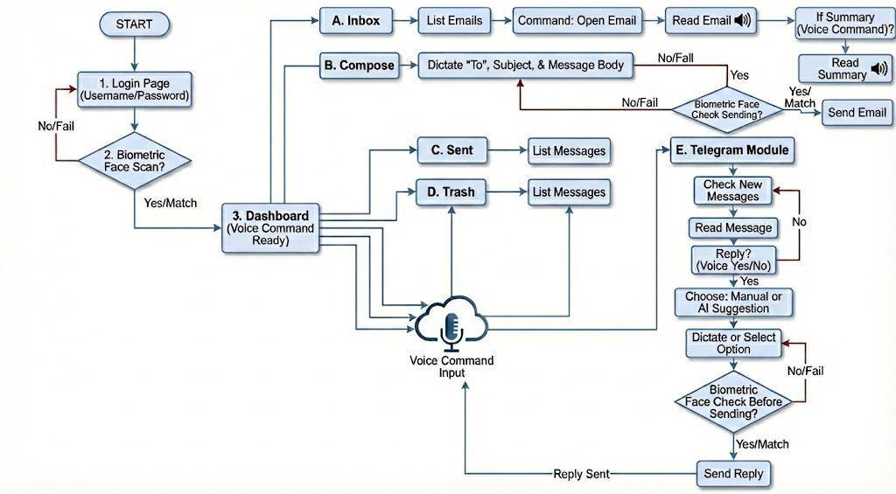

Slide 13


Unified Messaging Integration for Voice-First Messaging
Seamlessly connect Telegram through a unified voice-first interface that transforms how users interact with messaging platforms.
Telegram Bot API
Proactive Voice Alerts
Real-time message fetching using Long Polling technique to ensure instant notifications reach users without delay.
Announces sender name and group context before delivering message content for informed decision-making.

Slide 14
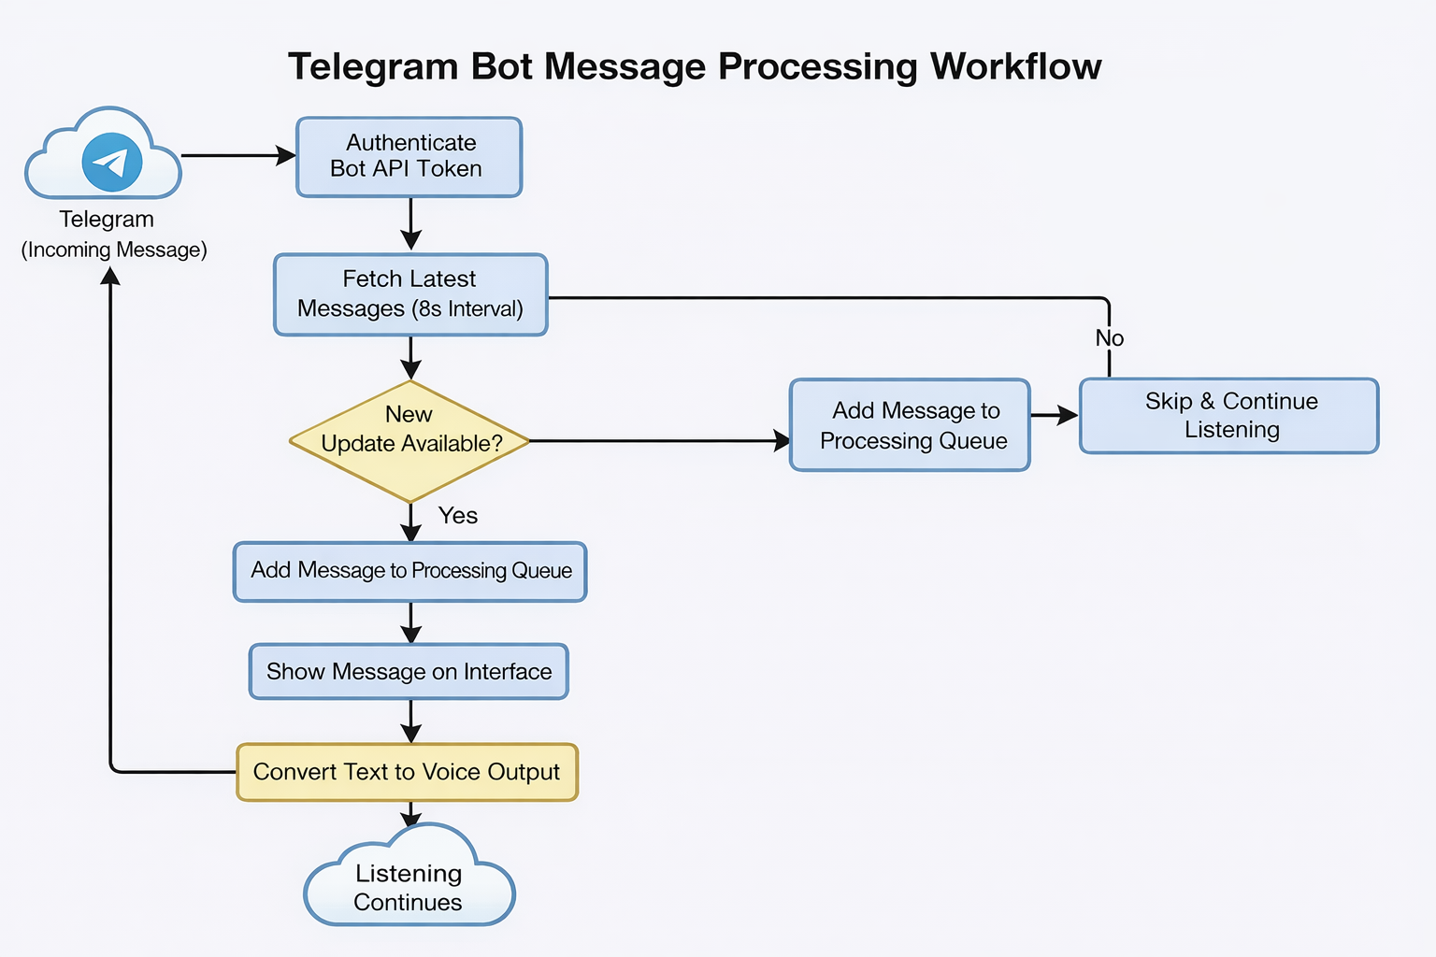

Slide 15

Intelligent Summarization for Cognitive Efficiency
The Challenge
Long emails and extended messages create cognitive fatigue when consumed entirely through voice output. Users need to listen through lengthy content to find relevant information.
The Solution
Gemini AI analyzes lengthy text and extracts essential elements:
Concise main summary
Clear action items
Sender's underlying intent

Slide 16
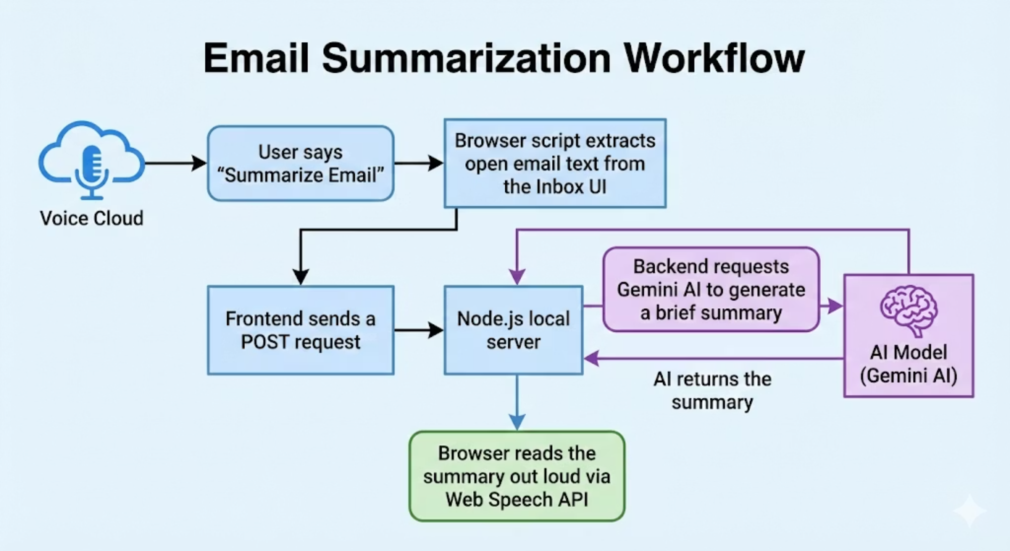

Slide 17
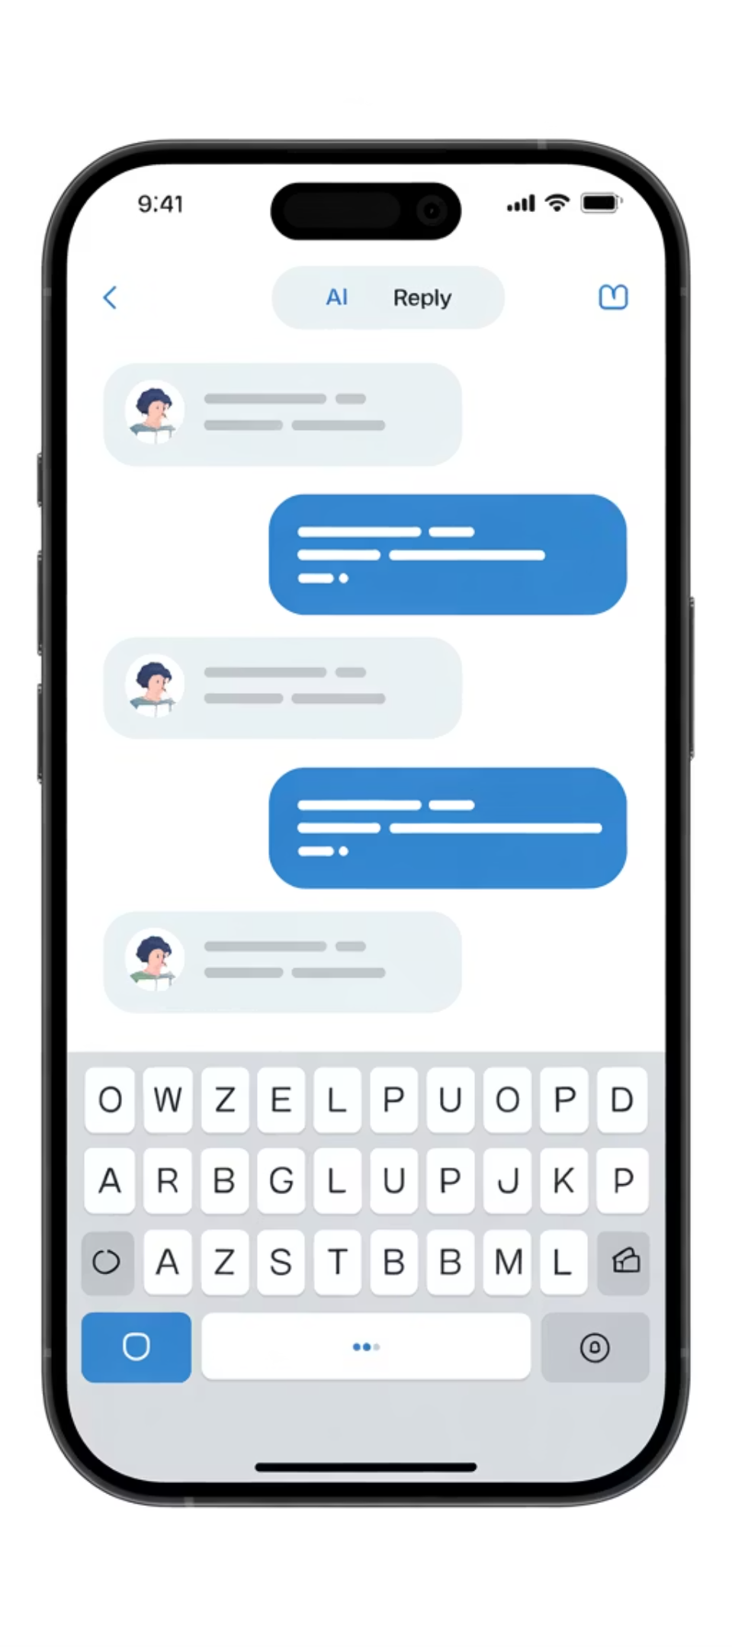
AI-Powered Smart Replies for Efficient Messaging
01
Context Collection
Current message plus previous 2 messages sent to AI model for complete conversation context
02
AI Generation
Generates 3 contextually appropriate reply options tailored to the conversation situation
03
Voice Presentation
System reads all options clearly, allowing user to review choices by listening
04
Quick Selection
User responds "Option One/Two/Three" and system sends selected reply instantly
Technical Architecture
Data Flow
Response Time
Messages transmitted securely through encrypted channels to AI processing engine with minimal latency.
Average generation time under 2 seconds ensures seamless conversation flow without interruption.

Slide 18
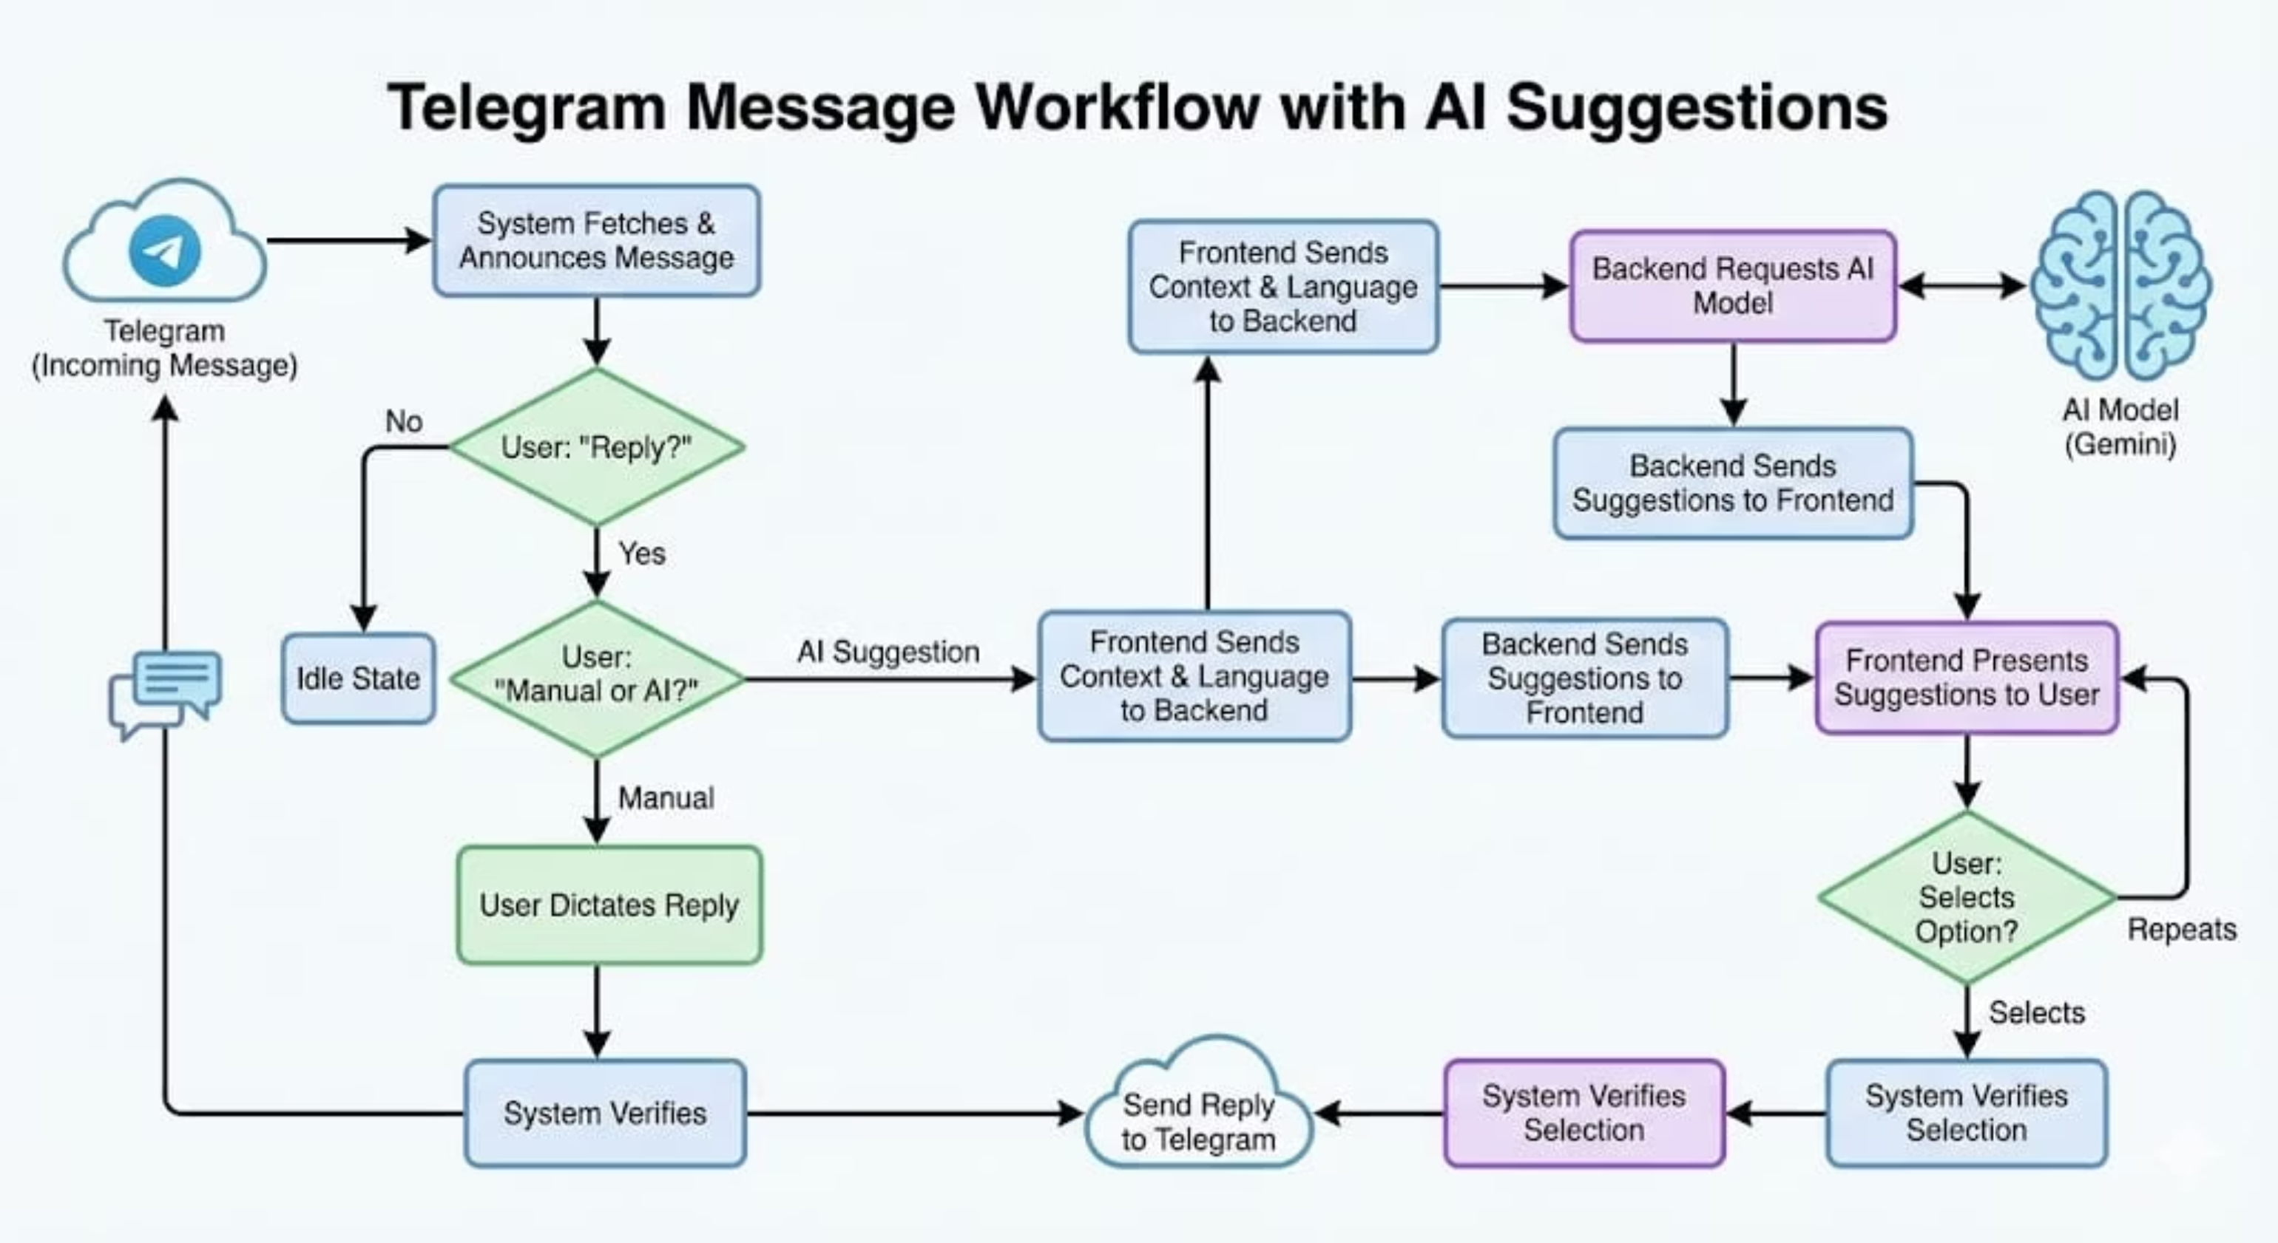

Slide 19

Biometric Active Authorization System
1
Active Authorization Layer
A face scan is now required before sending any message, shifting security from the Login Stage to the Action Stage. This prevents unauthorized message transmission by implementing dual verification: Digital Login + Physical Face Confirmation.
2
Protecting Sensitive Channels
This system actively prevents email misuse and data leaks, and secures Telegram from impersonation. It adds a final confirmation before transmission, significantly reducing human errors in sensitive communications.
Ensures intentional, verified, and secure communication.

Slide 20
TECHNICAL DEEP DIVE
Technical Workflow & Implementation Benefits
Face-Match Authorization Process
01
02
Initiate Action
Liveness Scan
User clicks "Send" or gives a voice command to initiate message transmission.
The device camera activates for a 4-second liveness scan to capture the user's face.
03
04
Biometric Comparison
Authorised Transmission
The captured image is compared with the securely stored cloud record for verification.
Message transmission occurs only if the confidence threshold for face-match is met.

Slide 21




Deployment From Localhost to Production Environment
Web Server on Render (Node.js)
Database on Cloud (MySQL)
Secure SSL Connection
Public URL Accessibility
Ensuring data integrity and privacy, all communication between the backend and database is secured via SSL encryption.
The application is readily accessible via a public URL, providing easy access and full independence from local hardware.
Our web server is hosted on Render, leveraging a robust Node.js environment for optimal performance and scalability.
The database is securely hosted on Aiven Cloud, offering a managed MySQL service with high availability and reliability.

Slide 22
Database Deployment & Key Benefits
Database – Aiven Cloud
Managed MySQL: Provides global accessibility with enterprise-grade features.
24/7 Availability: Ensures continuous service with automatic backups and failover.
IP Allowlist Configuration: Enhances security by restricting server access to authorized IPs.
SSL-Encrypted Communication: All database interactions are secured with SSL.
Key Benefits of Deployment
Guaranteed 24/7 internet accessibility from anywhere.
No local installation required, simplifying user onboarding.
Supports multi-device access (Mobile & Desktop) for flexibility.
Scalable infrastructure ready for multiple concurrent users.
A production-ready cloud infrastructure ensures reliability.

Slide 23
THANK YOU

